Slide 1

American Association of Physicists in Medicine Task Group 263: Standardizing Nomenclatures in Radiation Oncology
Charles S. Mayo, PhD, Jean M. Moran, PhD, Walter Bosch, PhD, Ying Xiao, PhD, Todd McNutt, PhD, Richard Popple, PhD, Jeff Michalski, MD, Mary Feng, MD, Lawrence B. Marks, MD, PhD, Clifton D. Fuller, MD, PhD, Ellen Yorke, PhD, Jatinder Palta, PhD, Peter E. Gabriel, MD, Andrea Molineu, MS, Martha M. Matuszak, PhD, Elizabeth Covington, PhD, Kathryn Masi, PhD, Susan L. Richardson, PhD, Timothy Ritter, PhD, Tomasz Morgas, Stella Flampouri, PhD, Lakshmi Santanam, PhD, Joseph A. Moore, PhD, Thomas G. Purdie, PhD, Robert C. Miller, MD, Coen Hurkmans, PhD, Judy Adams, MS, Qing-Rong Jackie Wu, PhD, Colleen J. Fox, PhD, Ramon Alfredo Siochi, PhD, Norman L. Brown, HScD, Wilko Verbakel, PhD, Yves Archambault, MS, Steven J. Chmura, Andre L. Dekker, Don G. Eagle, MS, Thomas J. Fitzgerald, MD, Theodore Hong, MD, Rishabh Kapoor, MS, Beth Lansing, Shruti Jolly, MD, Mary E. Napolitano, PhD, James Percy, Mark S. Rose, MS, Salim Siddiqui, MD, Christof Schadt, William E. Simon, MS, William L. Straube, Sara T. St. James, PhD, Kenneth Ulin, PhD, Sue S. Yom, MD, PhD, Torunn I. Yock, MD, MCH
International Journal of Radiation Oncology • Biology • Physics
Volume 100, Issue 4, Pages 1057-1066 (March 2018)
DOI: 10.1016/j.ijrobp.2017.12.013
Copyright © 2017 The Authors Terms and Conditions

Slide 2
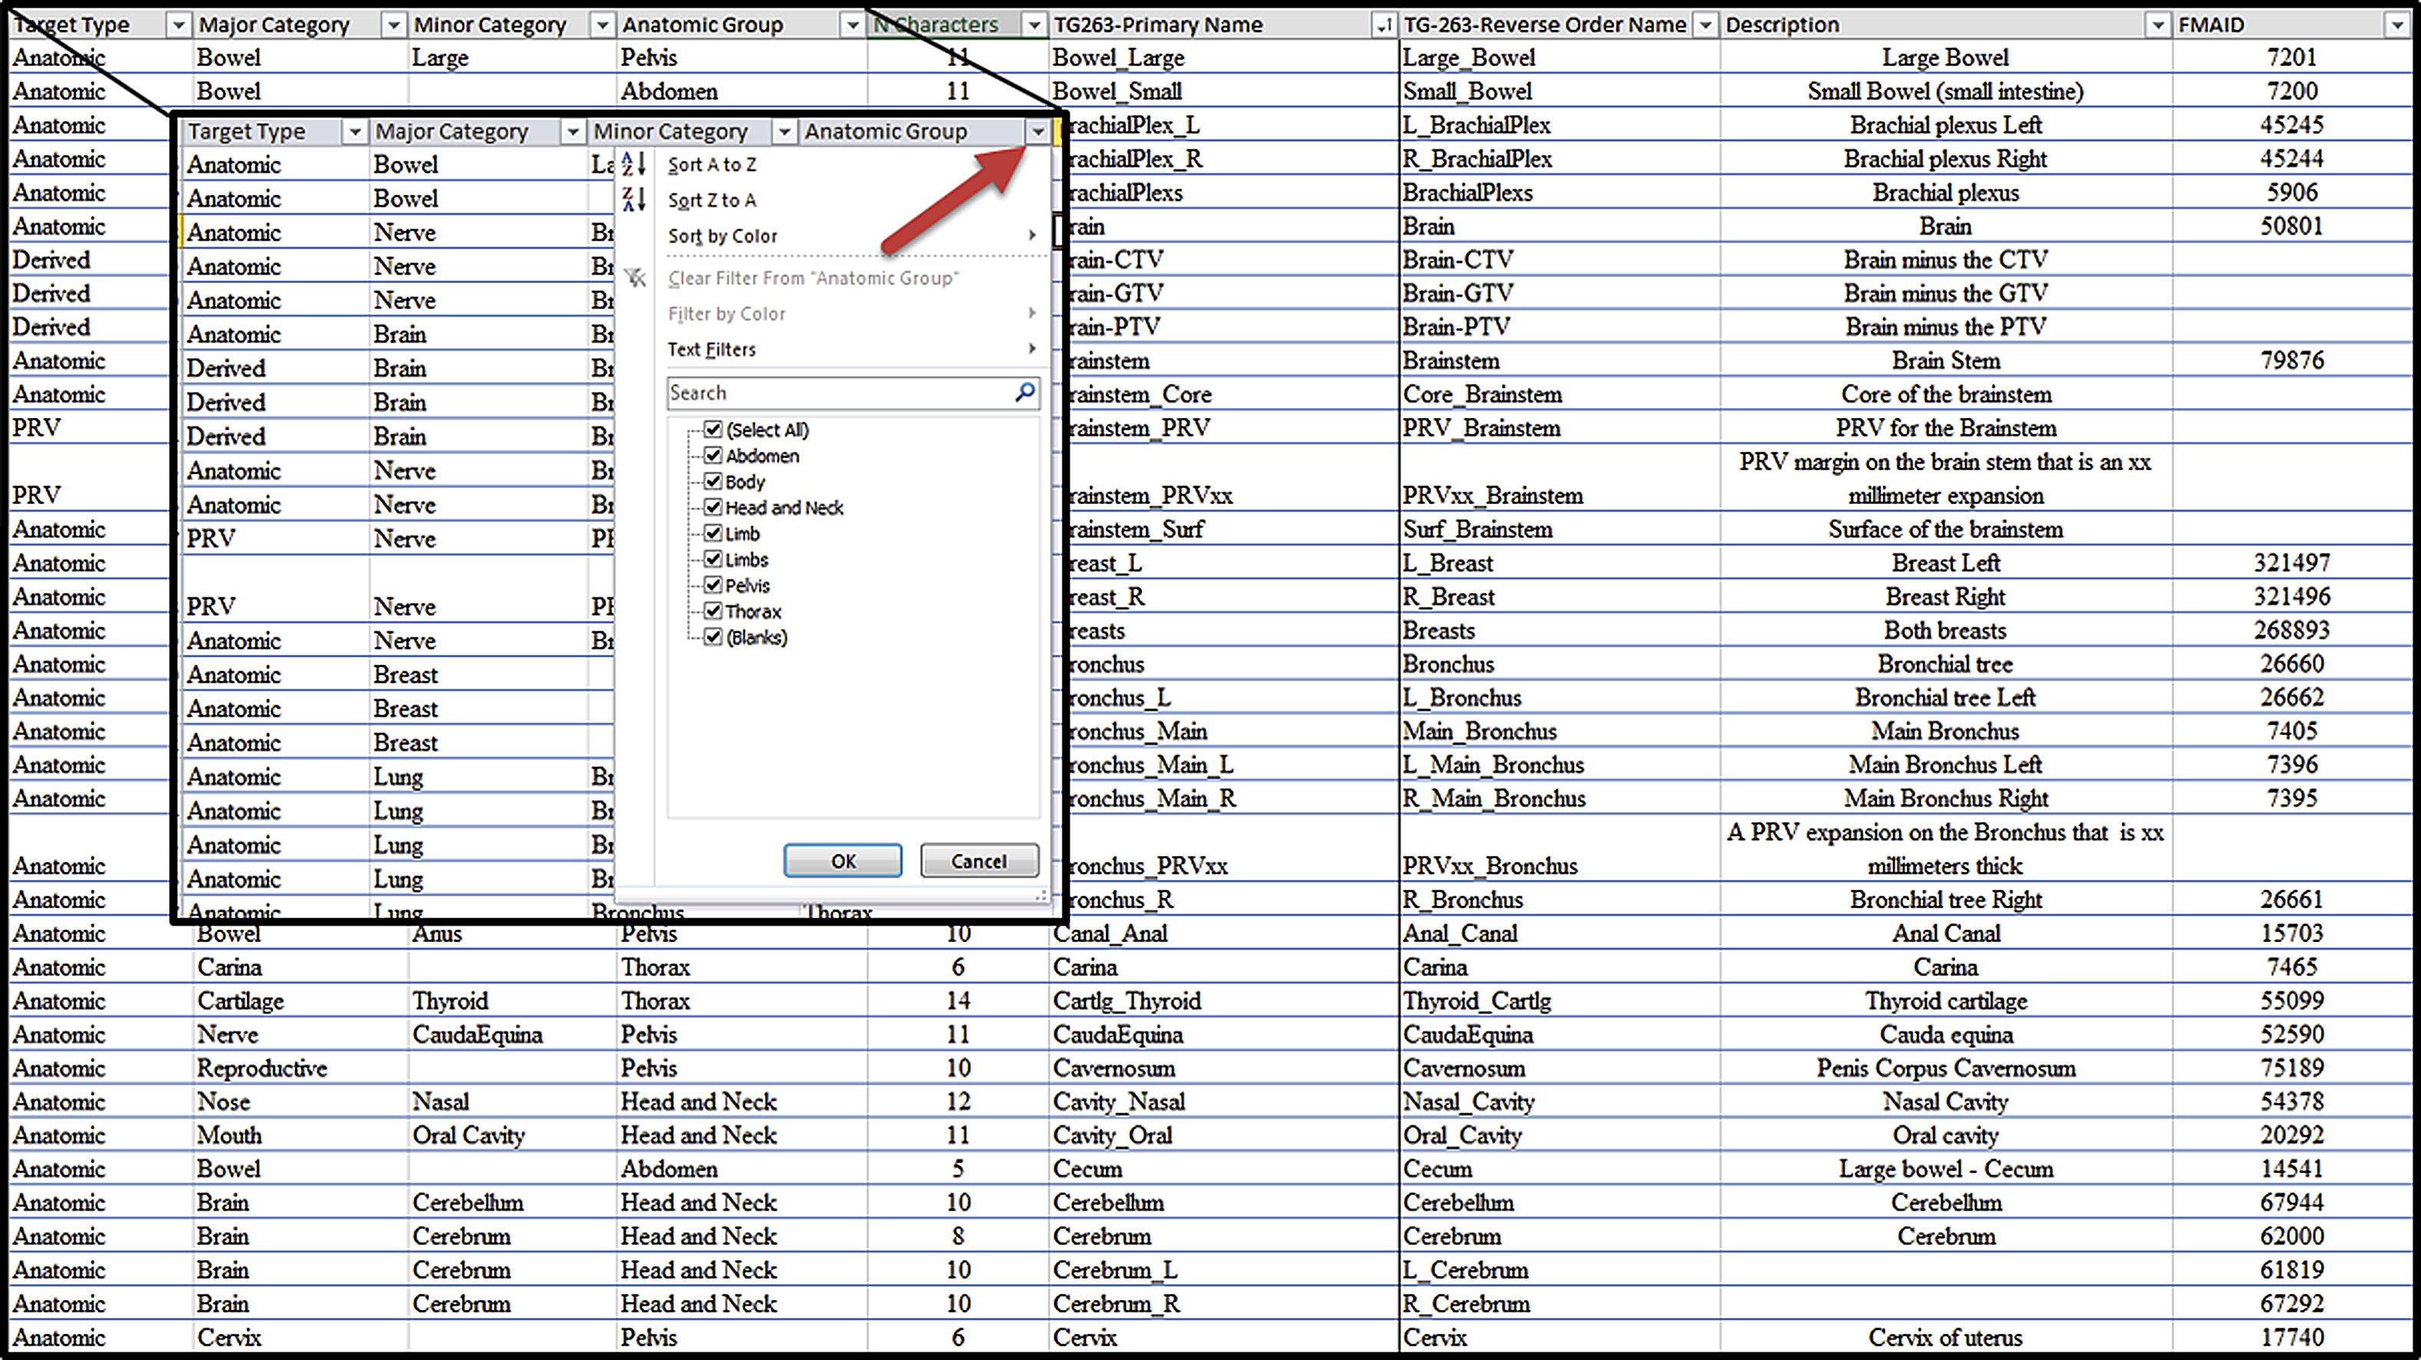
Fig. 1
International Journal of Radiation Oncology • Biology • Physics 2018 100, 1057-1066DOI: (10.1016/j.ijrobp.2017.12.013)
Copyright © 2017 The Authors Terms and Conditions
Notes:
Illustration of a section of the nomenclature list worksheet for nontarget structures. Each column allows sorting and searching by clicking on the down arrow to the right of the heading as shown in the zoomed region.

